Slide 1
CFO

Slide 2
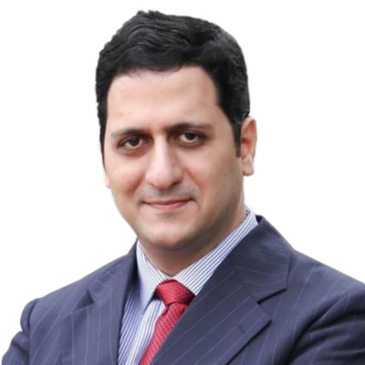
Harsh

Slide 3
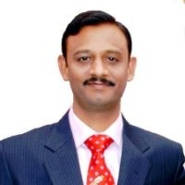
Mihir

Slide 4
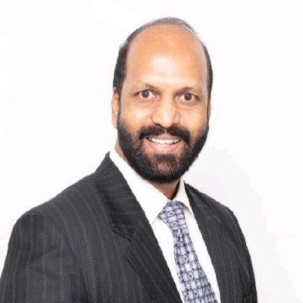
Jhon

Slide 5
CFO level candidate

